Slide 1
Sport vs Crime

Slide 2
Introduction
Sport can attract people and help them solve a number of problems that push them into crime:
Developing self-regulating and problem-solving abilities as a result of developing skills needed to sport activity.
Adventurous sport can satisfy the thirst for risk.
Sport helps people to socialize, playing sport, a person turns into a group, also can find friends and mentors, who provide positive role models.
I wanted to show that sports venues, such as sports fields, swimming pools, sports schools, can reduce crime in the city.

Slide 3
Data acquisition
The data about sports venues of a city from 4sq [foursquare.com]
The data about crime rates by cities from Wiki [en.wikipedia.org/wiki/List_of_United_States_cities_by_crime_rate.]
Translation the-state-name + city-name from GeoPy [github.com/geopy/geopy]

Slide 4
Data CLEANING
Drop rows (cities) with gaps in the table of crime statistical.
Limit the research to cities with a population of up to 500 thousand.
Drop cities with too little data about sports venues.
Features: city population and numbers of sports venues by categories per inhabitant.
Target: whether the crime rate of a city is higher than the median?

Slide 5
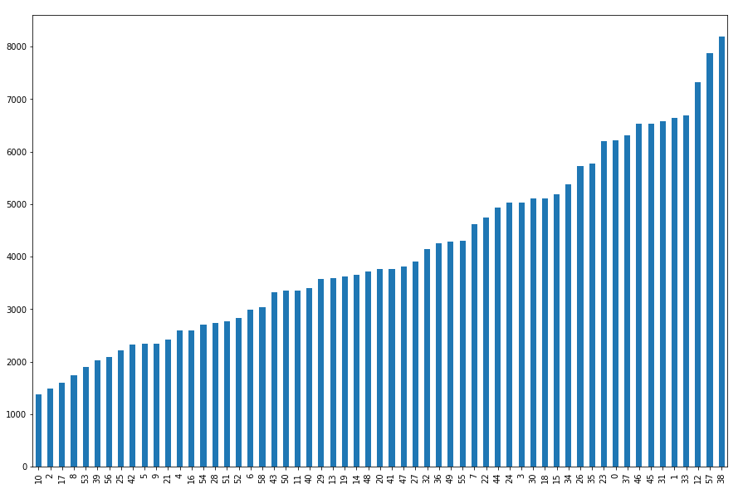
Histogram of Crime Rate

Slide 6
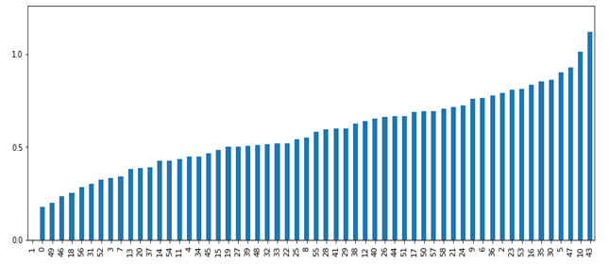
Histogram of Number of sports venues per inhabitant

Slide 7
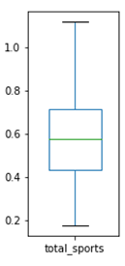
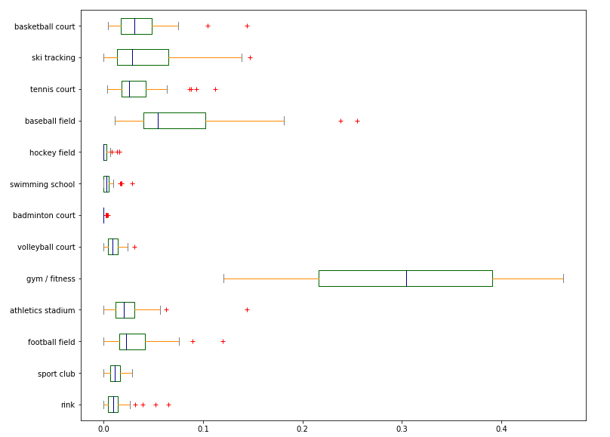
BOXES OF SPORTS VENUE STATISTIC

Slide 8
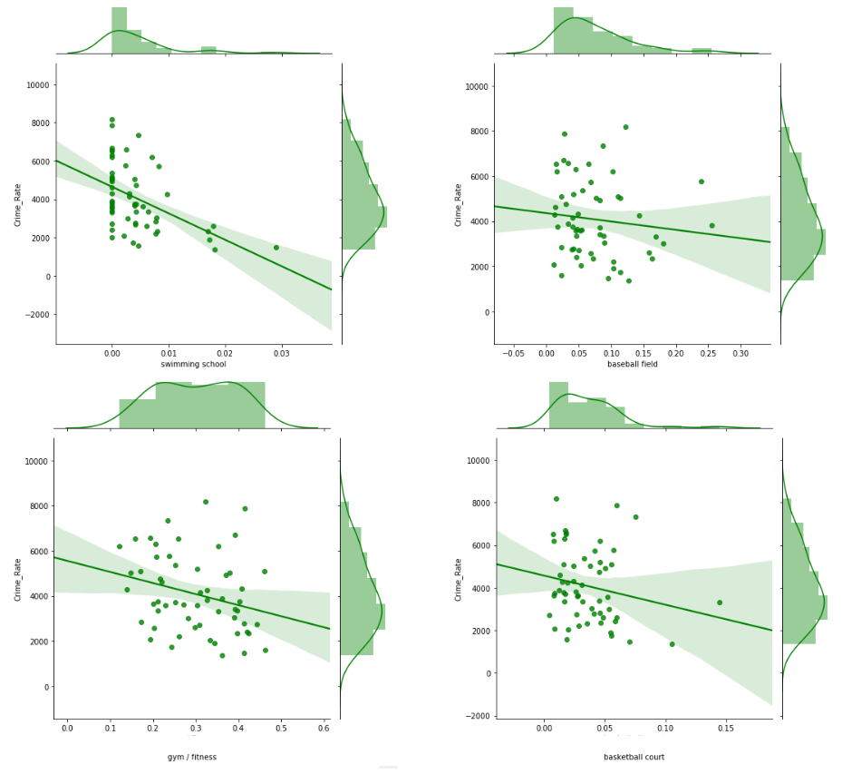
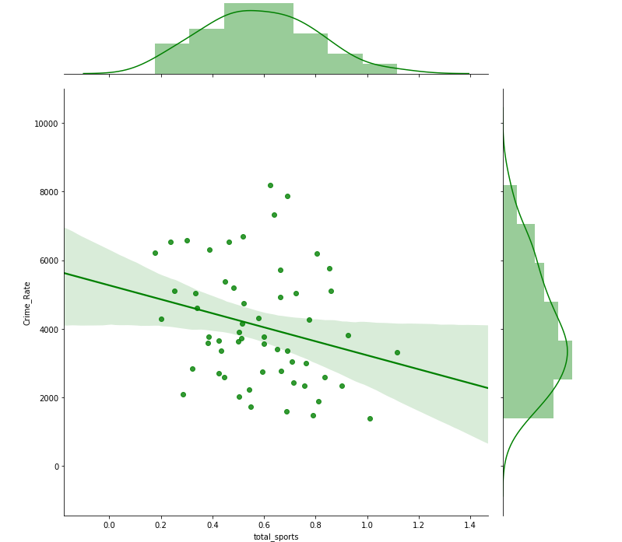
Relationships between crime rate and SPORTS VENUES

Slide 9
PERSON CORRELATIONS
Feature | Correlation with the crime rate
swimming school | -0,47
gym / fitness | -0,28
total sports | -0,26
volleyball court | -0,26
basketball court | -0,20
athletics stadium | -0,18
sport club | -0,18
football filed | -0,16
tennis court | -0,14
baseball field | -0,12
ski tracking | -0,06
badminton court | 0,01
hockey field | 0,13
rink | 0,14

Slide 10
CLASSIFICATION MODELING
I used different type of ML algorithms (implementations were provided by scikit-learn):
k-Nearest Neighbors (kNN)
knn_model = KNeighborsClassifier(n_neighbors = 4).fit(X_train,y_train)
Support Vector Machine (SVM)
svm_model = svm.SVC(kernel = 'rbf', degree = 3, probability=True).fit(X_train,y_train)
Decision Tree (DT)
tree_model = DecisionTreeClassifier(max_depth = 2).fit(X_train, y_train)
Logistic Regression (LR)
lr_model = LogisticRegression(solver = 'lbfgs', C = 0.2).fit(X_train, y_train)
Multilayer Perceptron (MLP)
mpl_model = MLPClassifier(hidden_layer_sizes = (4, 1), activation = 'relu', random_state = 0).fit(X_train, y_train)

Slide 11
CLASSIFICATION RESULTS
whether the crime rate of a city is higher than the median?
Classifier | Accuracy | Precision | Recall | F1-score
kNN | 57 % | 58 % | 58 % | 58 %
SVM | 65 % | 67 % | 67 % | 67 %
Decision Tree | 56 % | 58 % | 58 % | 58 %
Logistic Regression | 65 % | 67 % | 67 % | 67 %
Multilayer Perceptron | 73 % | 71 % | 83 % | 77 %

Slide 12
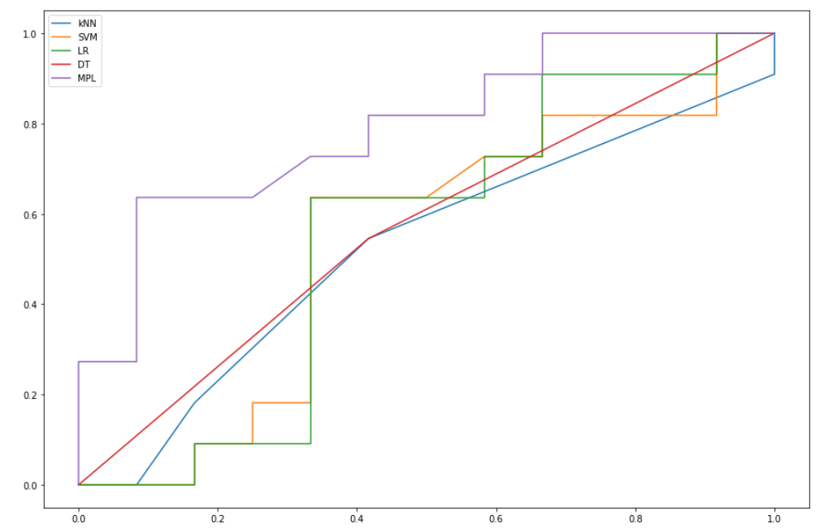
ROC CURVE
True positive rate
False positive rate

Slide 13
Conclusion & Future directions
Despite the fact that so far only a small exploration work has been carried out in this area of the research, I dare to formulate the following conclusion.
Based on the results obtained, it should be recommended to invest in low-cost sports facilities for the long-term sustainable development of their city.
Thus, I think that the initial phase of this study presented here gives showed the promise of this study. It can be continued to produce more reasonable results.
In the future, the study can be significantly deepened by expanding the sample of output data, using not only the number of institutions but also their rating, as well as the division of crime statistics by age categories.

